Slide 1
My journal in python
Name:andrea escobello

Slide 2
AGENDA
.Python
.Input and output; input () and print ()
.Data types:numerics,strings,list,dict
.Operators On data type:
CONTROLS ; IF- | IF -ELSIF|-F-ELSE
.LOOP:FOR |WHILE|RANGE 0|BREAK|CONTINUE
.FUNTION:
.PARAMETERS ()

Slide 3
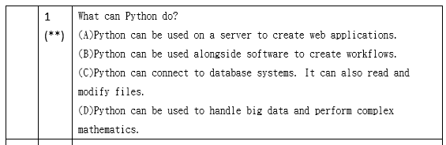
PYTHON
What can Python do?
Python can be used on a server to create web applications.
Python can be used alongside software to create workflows.
Python can connect to database systems. It can also read and modify files.
Python can be used to handle big data and perform complex mathematics.
Python can be used for rapid prototyping, or for production-ready software development.

Slide 4
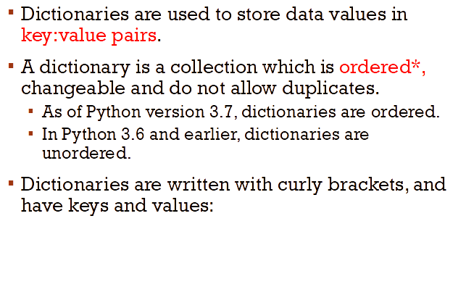
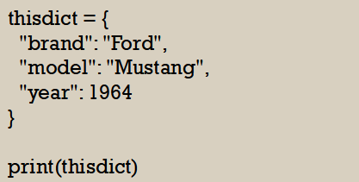
key:value pairs

Slide 5
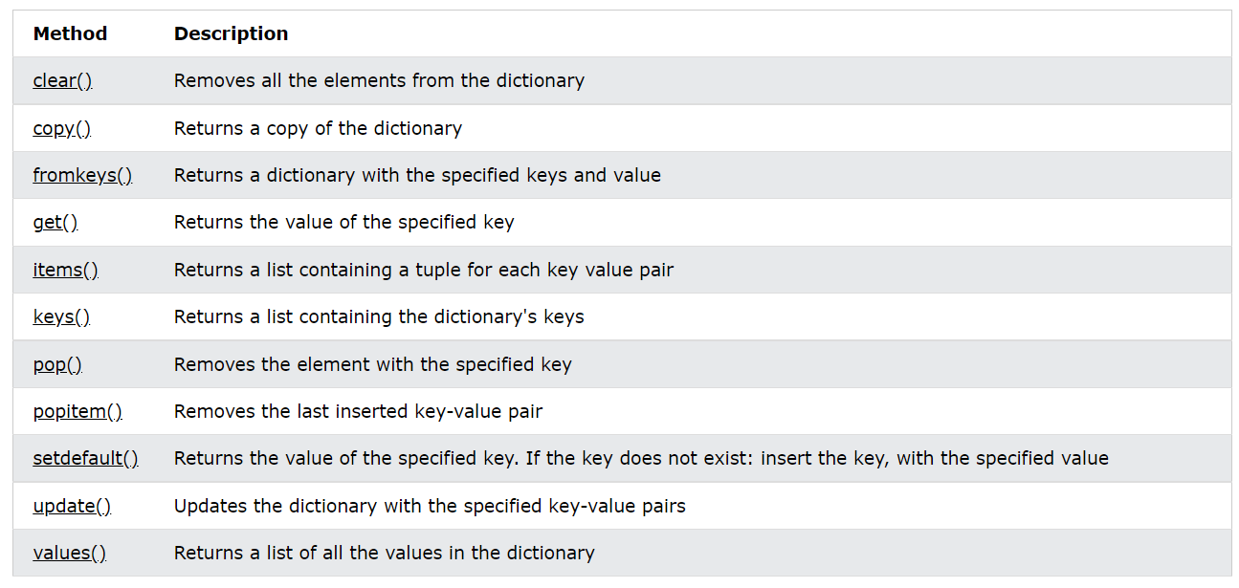
Dictionary methods

Slide 6
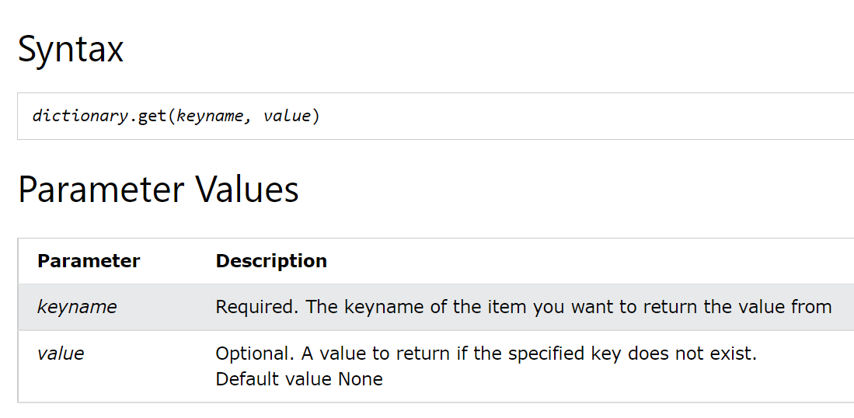
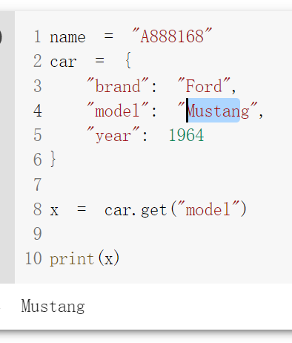
Get()

Slide 7
